Slide 1
Perry
ISU Community Visioning
2012 – Educational Presentation

Slide 2
Goals for Visioning Program
Developing a conceptual plan and implementation strategies with local communities.
Enhancing the natural, cultural, and visual resources of communities
Assisting local communities in using external funds as leverage for transportation corridor enhancement
Each visioning community works through a planning process consisting of four phases of concept development:
Program initiation
Needs assessment and goal setting
Development of concept plan
Implementation and sustained action
Program Overview

Slide 3
Community Goals
Develop a network of community trails
Provide route suggestions for community-wide plan
Develop amenities boards with wayfinding opportunities
Develop a plan for pedestrian enhancements to 1st Avenue
Provide pedestrian connection to BAR JAC Estates
Develop traffic calming techniques for roadway
Develop entrance signage
Prepare sign design and propose locations
Prepare plans for selective screening along trails
Program Overview

Slide 4
Proposed Concepts
Community Entrance Signage
Trail Artwork & Wayfinding
Screening Opportunities
Community Trails Master Plan
1st Avenue Pedestrian Enhancements
1st Avenue Traffic Calming
Concept Plan

Slide 5
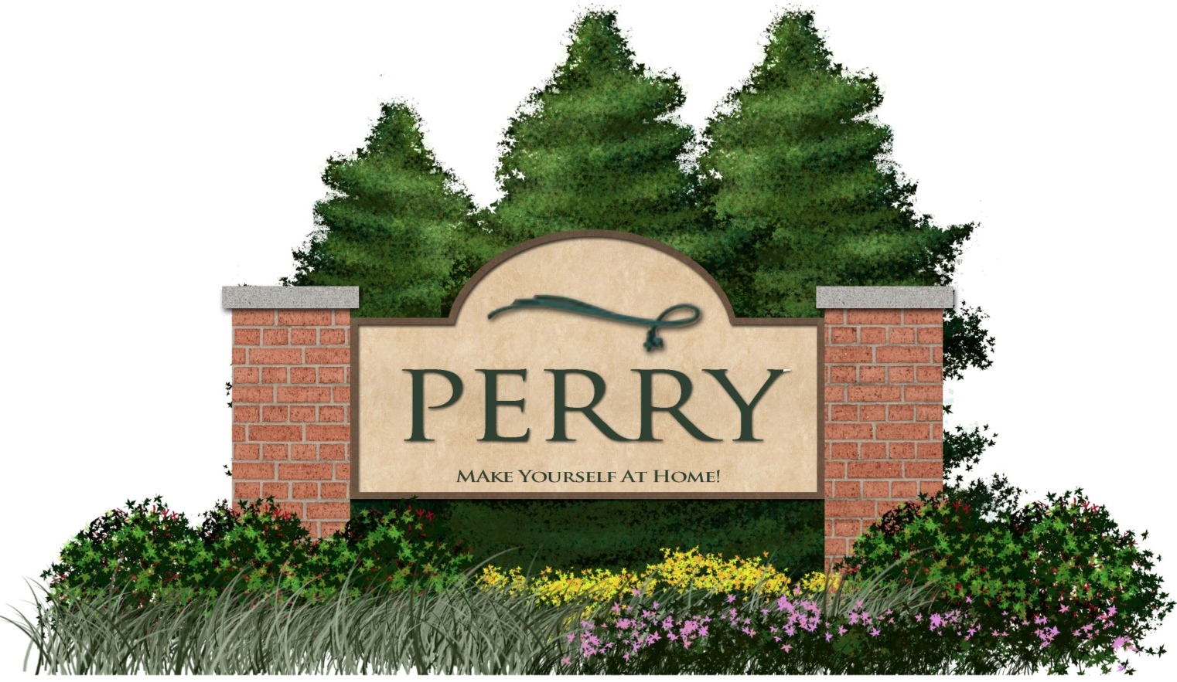
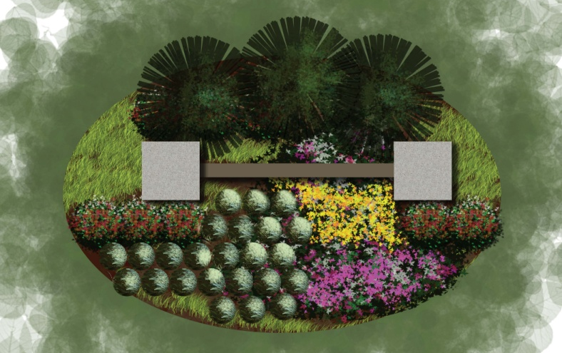
Community Entrance Signage – Section and Plan
Signage meant to attract attention and signal arrival in Perry
Landscaping around the sign helps reinforce the sign and
attract peoples attention
Signs placed at major entry points to community from
the north, south, east, and west
Scaled to be easily readable at highway speeds
Community Entrance Signage

Slide 6
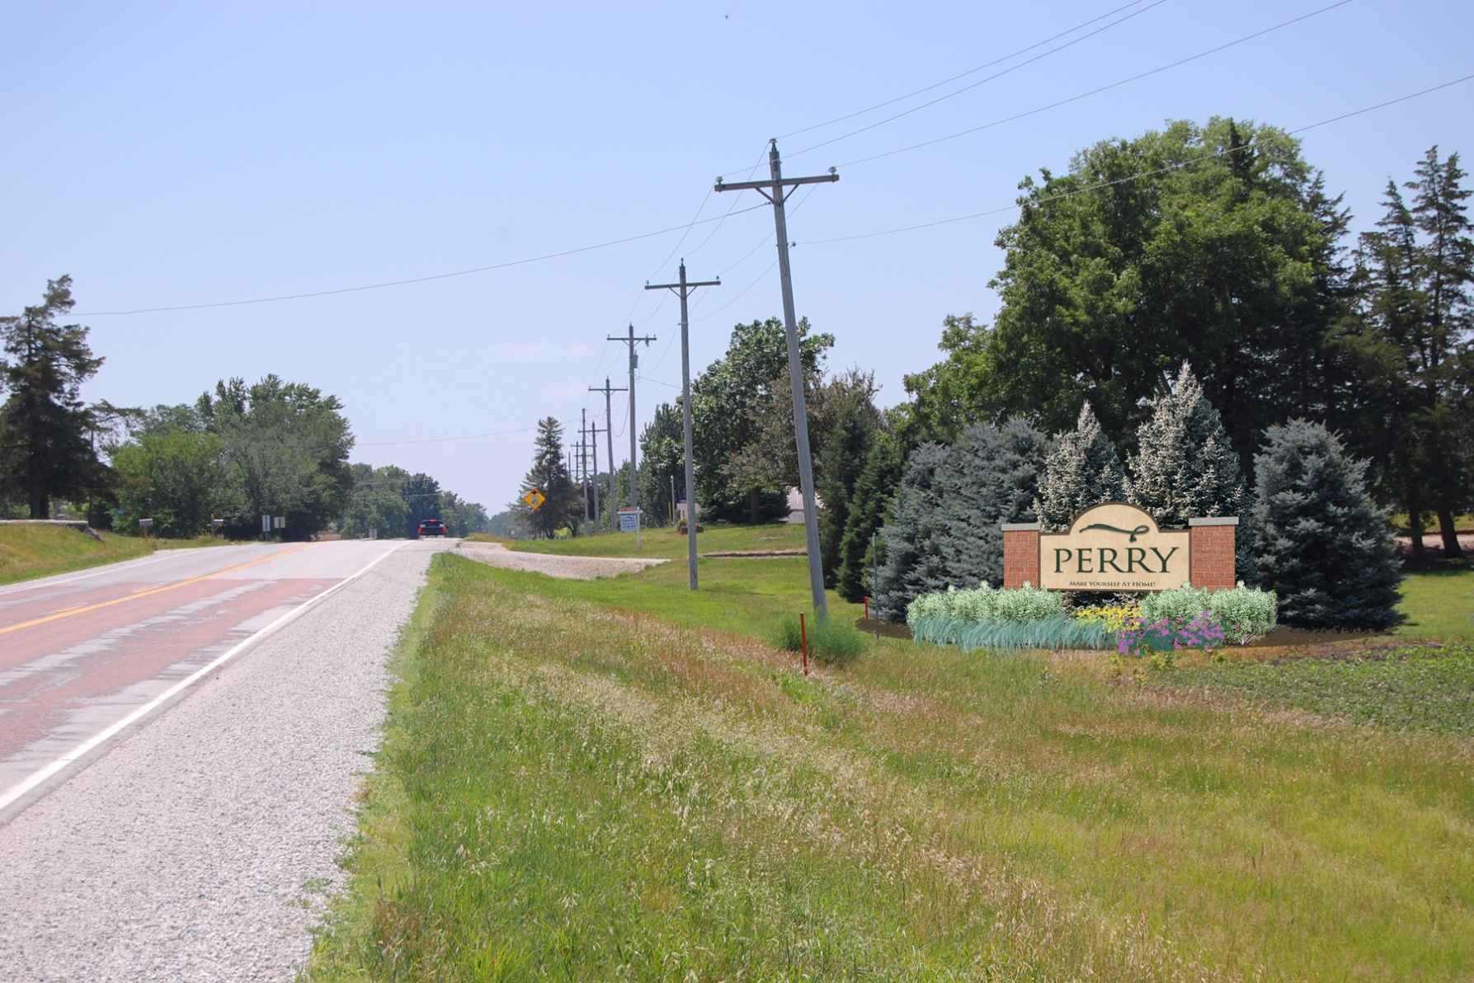
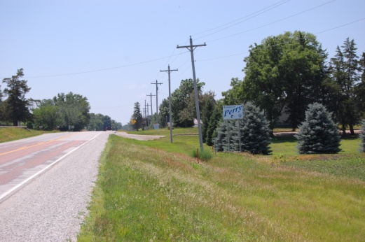
After
Before
Proposed Perry Community Signage along Highway 144
Community Entrance Signage

Slide 7
F58
173
Proposed locations for community signage
Community Entrance Signage

Slide 8
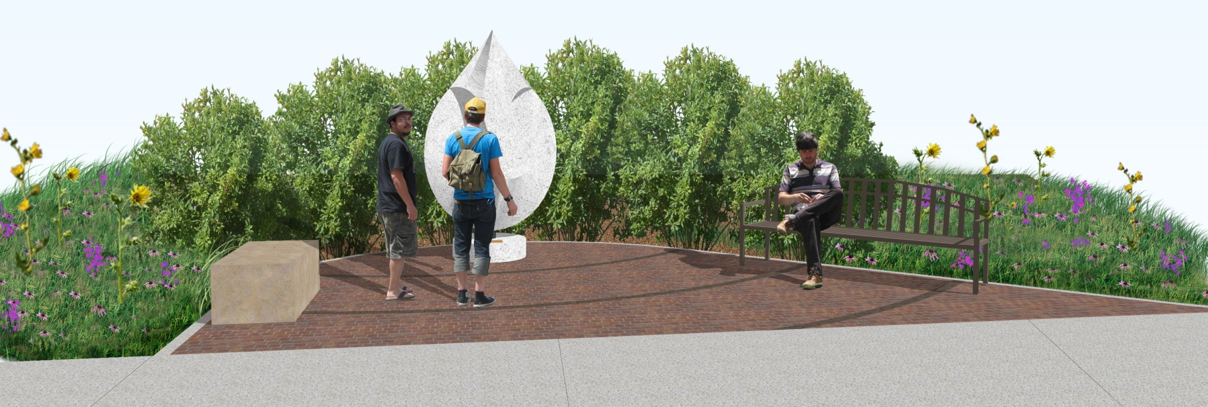
Proposed trail node along recreation trails
Nodes introduce artwork and opportunities
for rest/relaxation to the trail system
Wayfinding signage identifies the respective
trail system, and local attractions
QR code allows smart phone users to
access maps and community information
Proposed wayfinding signage
Trail Artwork & Wayfinding

Slide 9
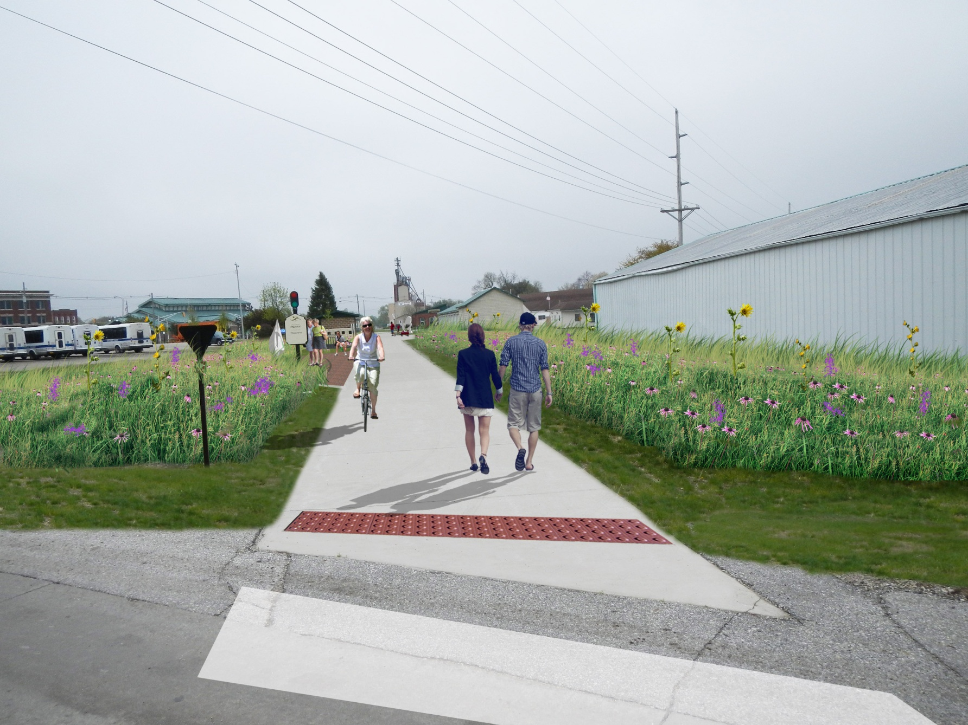
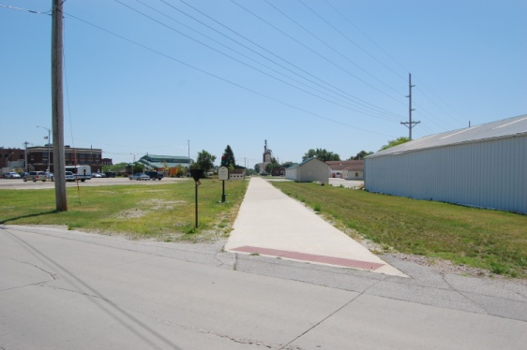
Danish Villages Signage – Plan
After
Before
Proposed modifications to Raccoon River Valley Trail near Caboose Park
Trail Artwork & Wayfinding

Slide 10
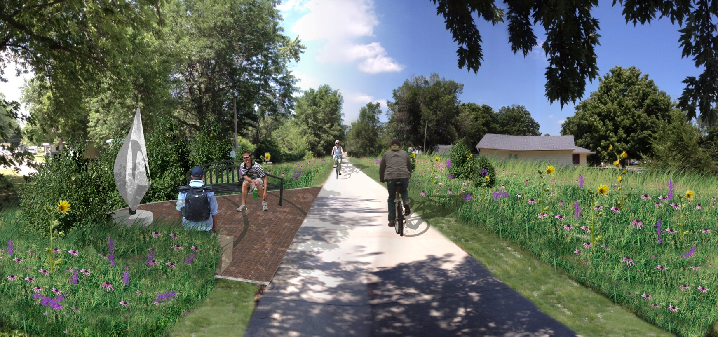
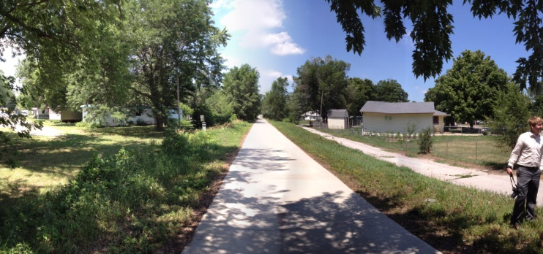
After
Enhancement opportunity along existing trails
Plantings provide interest along trails
Incorporate artwork, seating, and plantings in high traffic areas
Provide screening in key areas
Before
Screening Opportunities

Slide 11
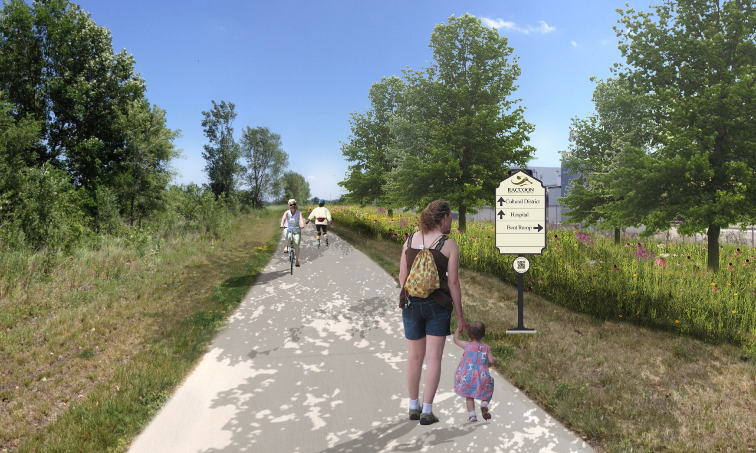
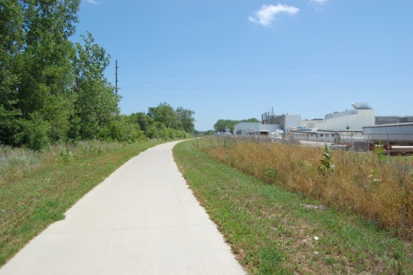
After
Screening along the north side of the Tyson plant
Before
Screening Opportunities

Slide 12
Proposed trails provide links to existing trails and other nearby communities
Community Trails Master Plan

Slide 13
Northern portion of 1st Avenue with critical intersections highlighted
Urban Path
Rural Path
Provide a safer method of pedestrian access north of town
Design for both urban and rural portions of roadway
Urban consists of a separated 6-8’ path
Rural consists of a widened 10’ shoulder accessible by pedestrians
1st Avenue Pedestrian Enhancements

Slide 14
Northern portion of 1st Avenue with critical intersections highlighted
Provides more visibility at intersections through painted crosswalks
Provides accessible sidewalk approaches at key
intersections
Widened 6-8’ sidewalks along 1st Avenue
Reduce 4 lane road to 3 lanes (one lane each direction with a central turning lane)
Typical improvements at key intersections
1st Avenue Traffic Calming

Slide 15
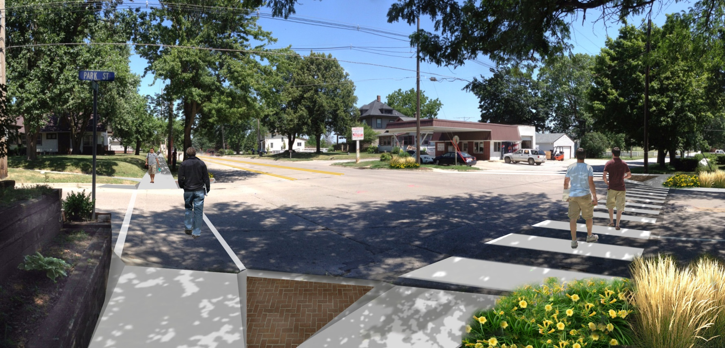
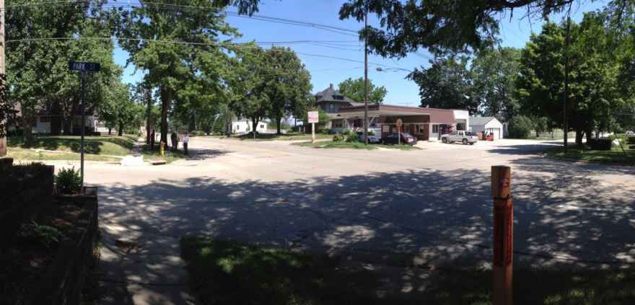
After
Intersection of Park Street & 1st Avenue
Before
1st Avenue Traffic Calming

Slide 16
Contact information
Address/Email | Bolton & Menk Inc.
Joshua Shields
2730 Ford Street
Ames, IA 50010
ph: 515.233.6100
Fax: 515.233.4430

